Slide 1

WEEK 5 REPORT

Slide 2
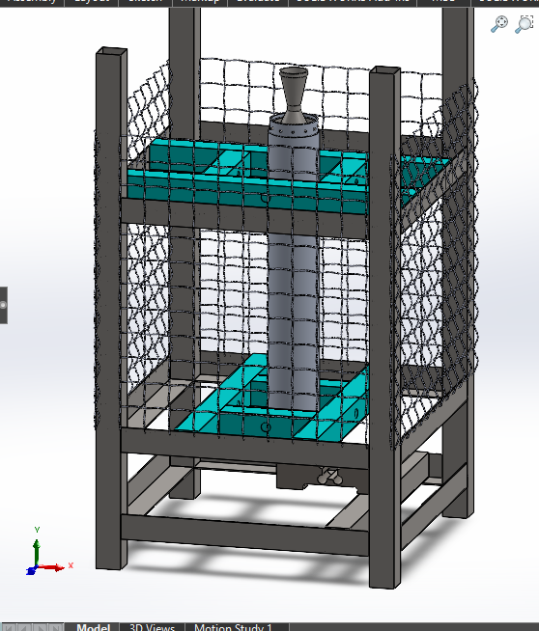
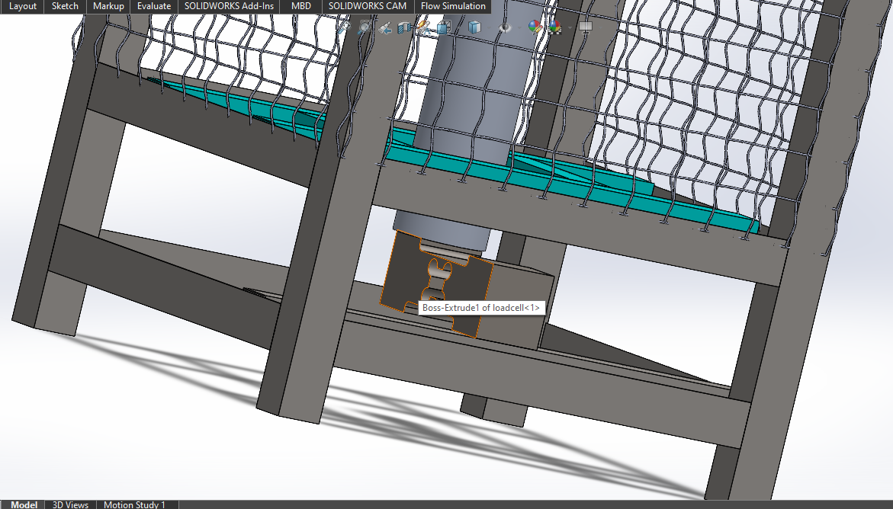
STATIC TEST STAND
Weight 14kg
Dimensions 85cm 50cm x 50cm
Disassembly
Fabrication
Welding
Grinding
Bolts and nuts assembly
Materials
Angle line
Aluminum tube
Square steel tubes
Bolts and nuts

Slide 3
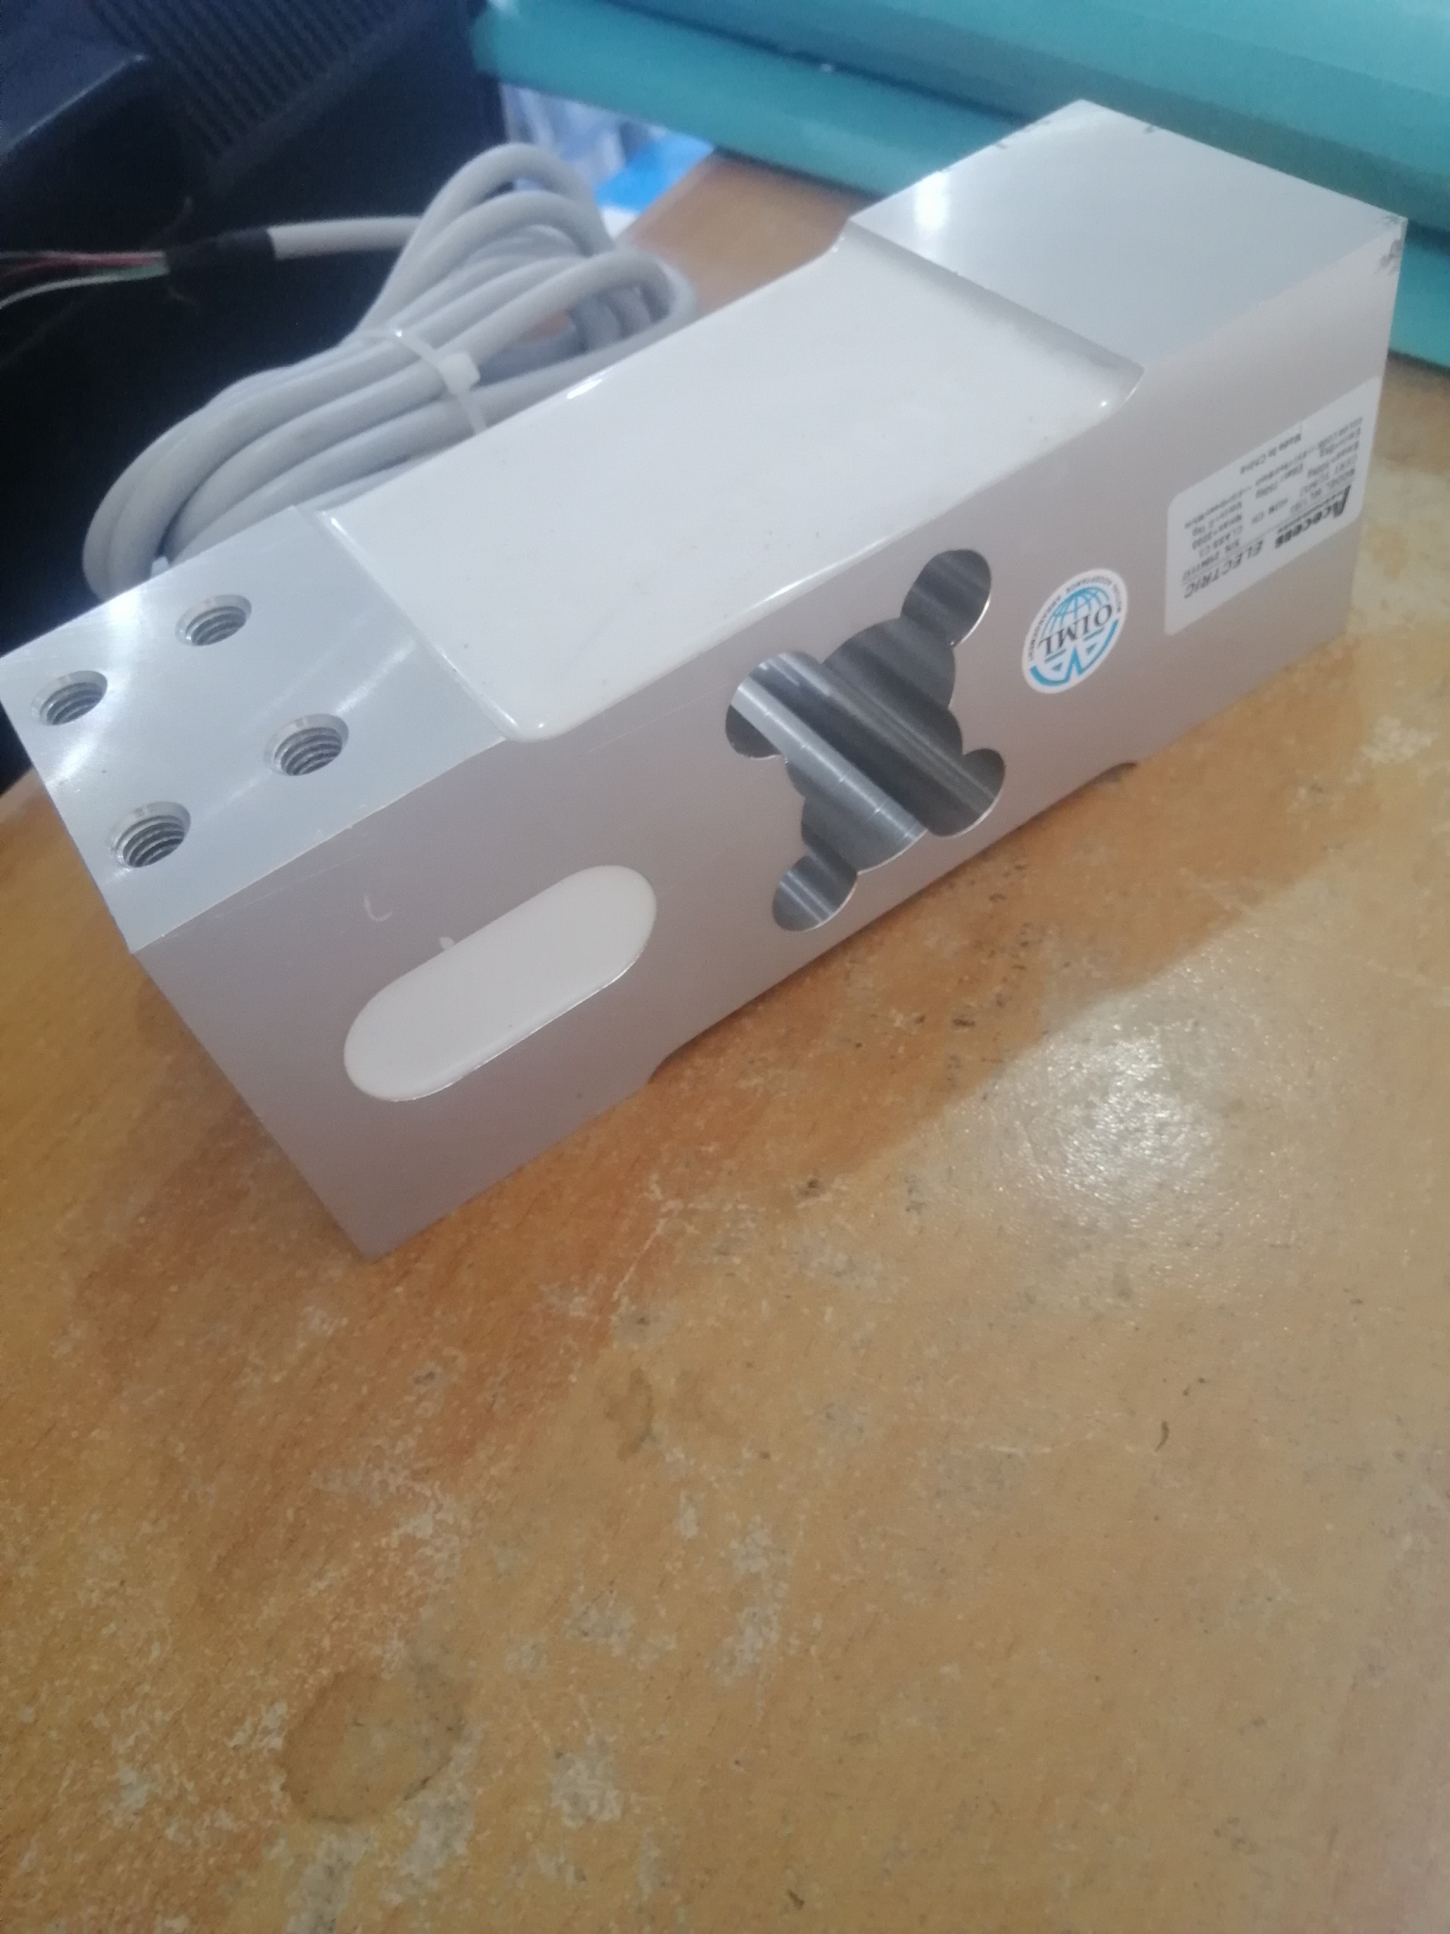
LOADCELL
SPECIFICATIONS
Single point
500kg capacity
KSH 15000 + vat

Slide 4
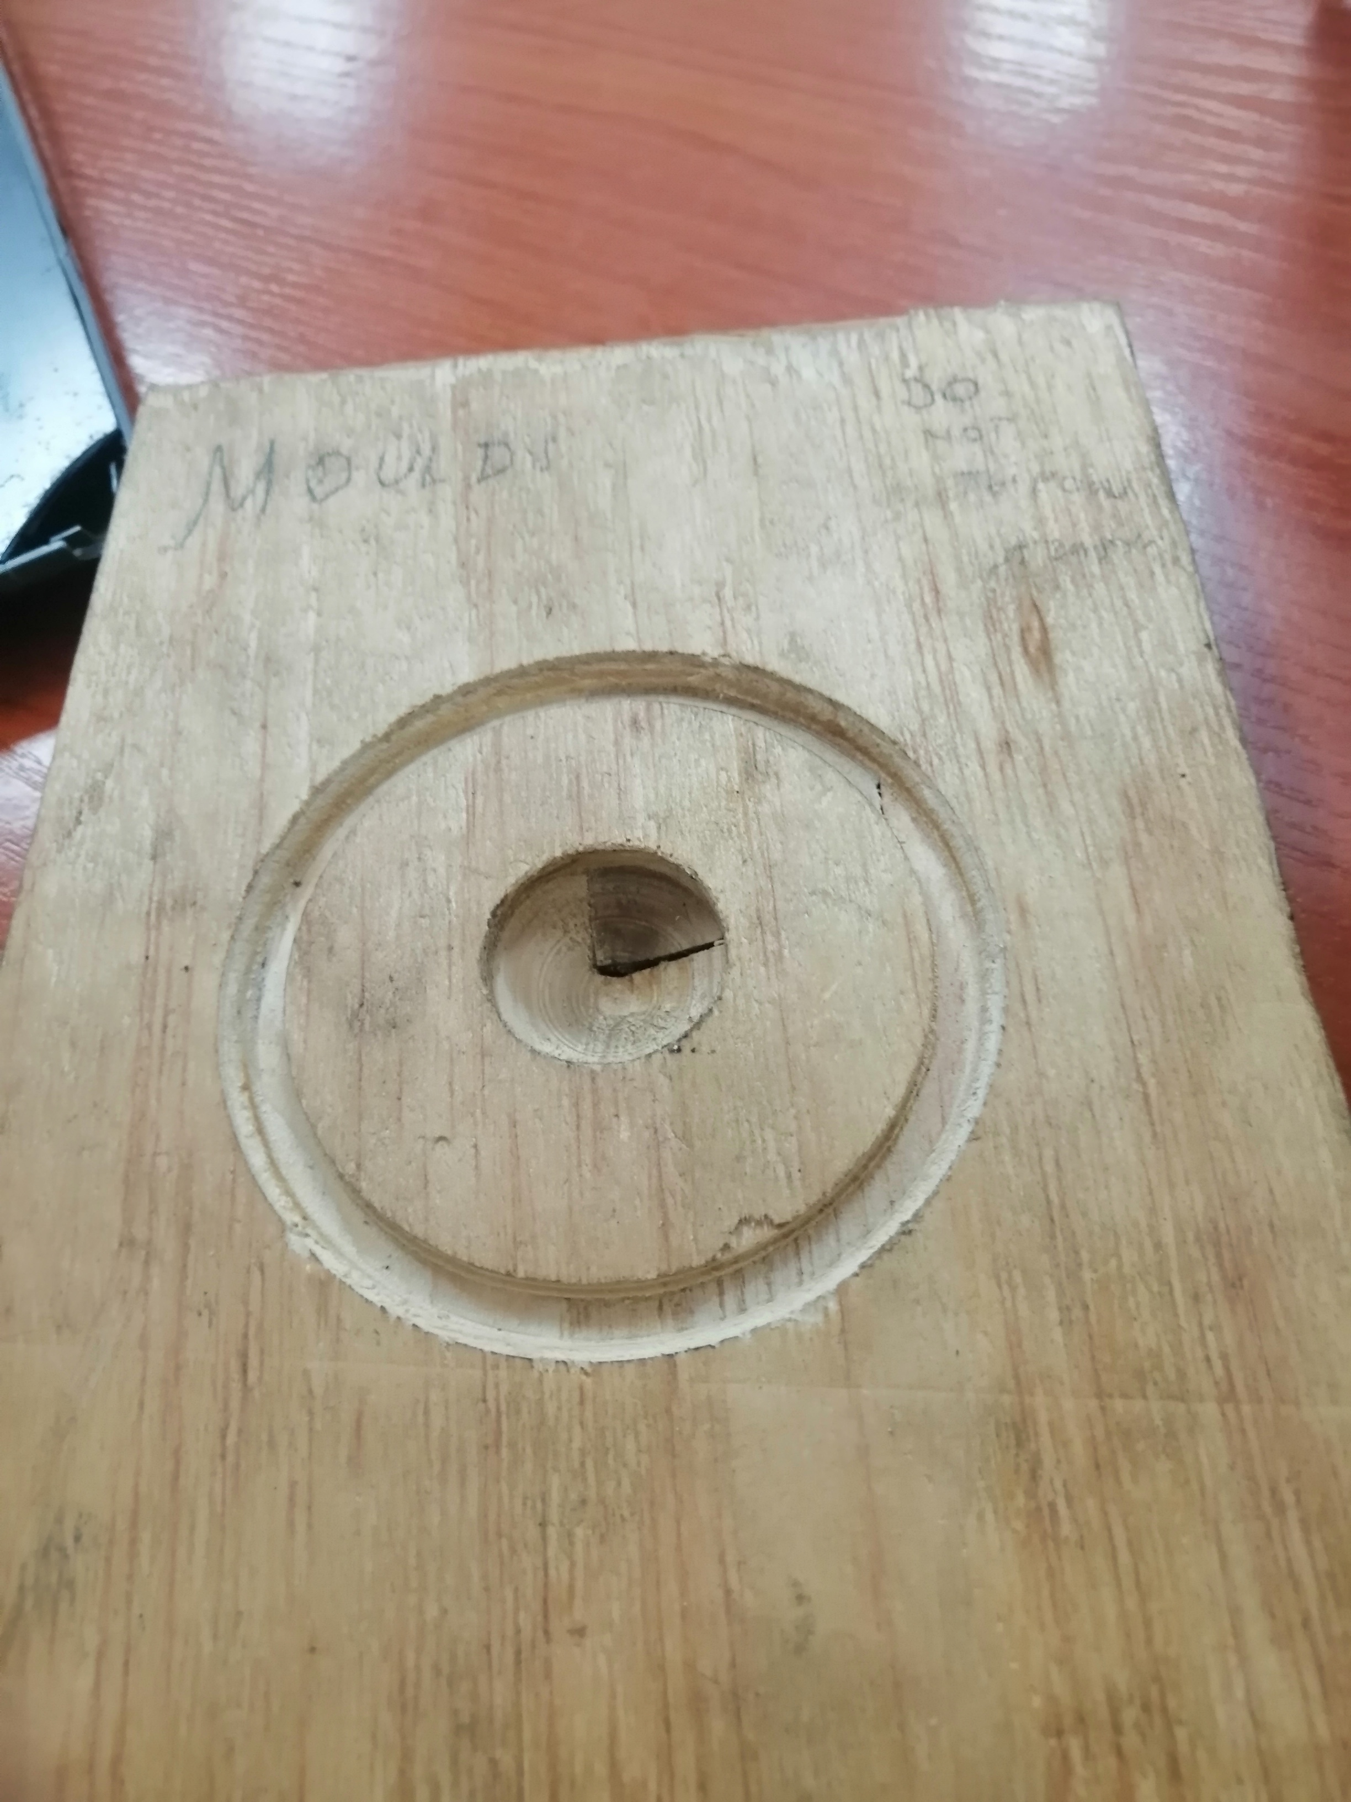
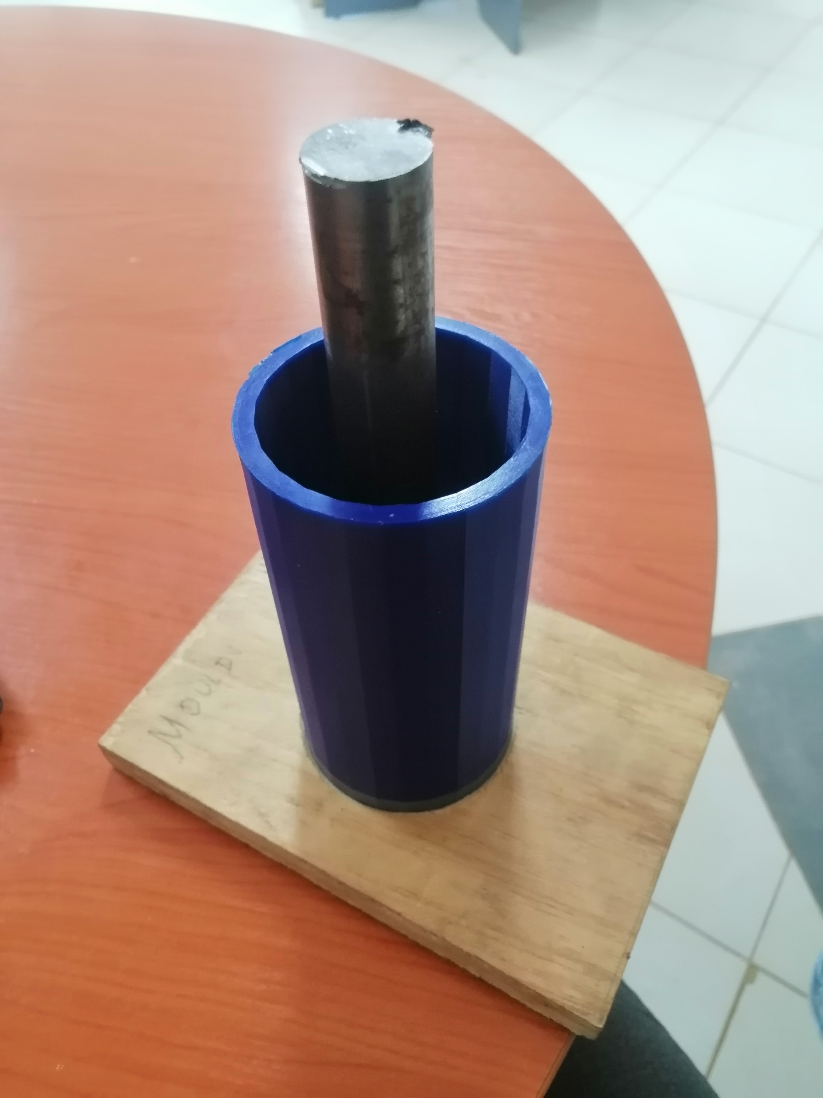
Propellant moulds
Liner – cardboard

Slide 5
Aluminum casing
ID 70mm
OD 75mm
Aluminum 6061-T6 /7075-T6
Modern casements
ID 74mm
OD 77mm

Slide 6
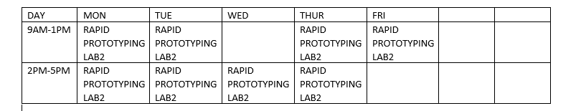
LAB sCHEDULE

